Slide 1
How I saved the World with Dailyclean, an open sourced tool developped in Quarkus
Guillaume THOMAS
Notes:
Hi eveyone ! Welcome to this talk.
My name is Guillaume and today, I would like to tell you a wonderful tail about GraalVM and Quarkus.

Slide 2
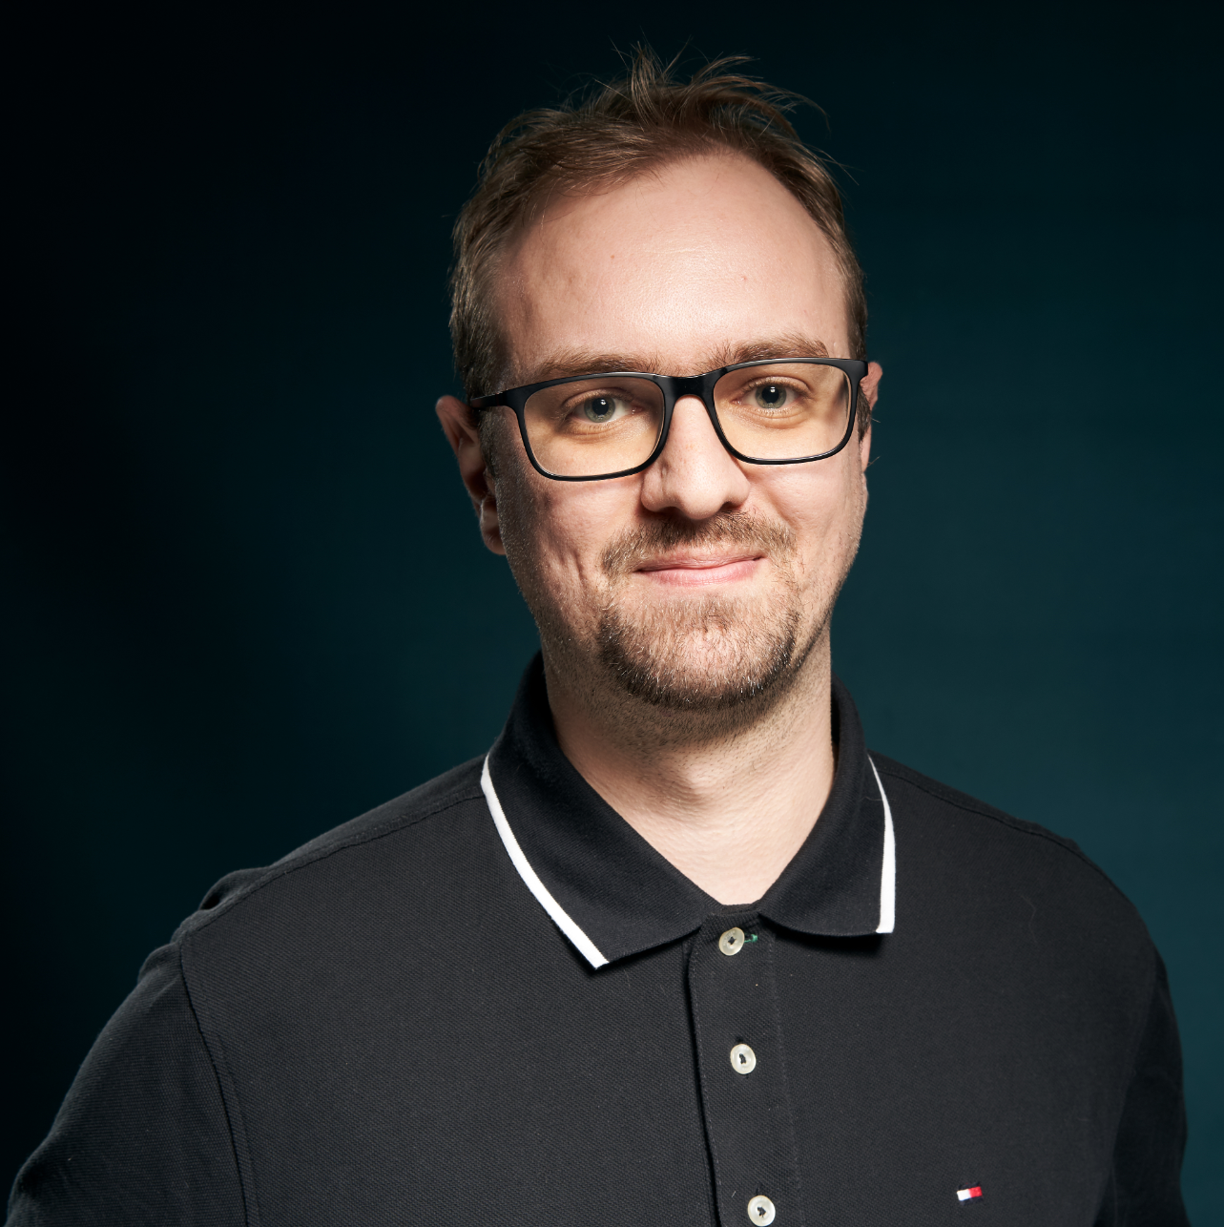
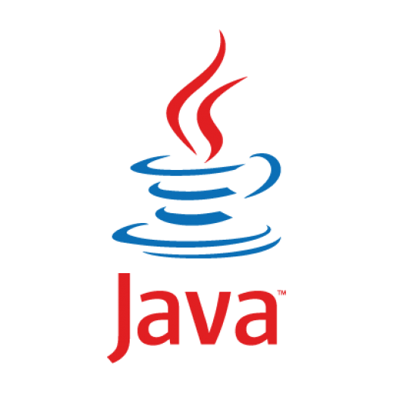
Guillaume THOMAS
ML Engineer
BigData & New Technologies @AXAFR
Notes:
Our story begins in AXA France.
First, let me introduce myself. I'm currently working as an ML developer in a team called : BigData and new technology.
Our mission is to help Data scientists to make their AI applications working in production efficiently.
Often, these types of applications execute a lot of processes. So, we design our solutions as microservices.

Slide 3
Demonstration
Notes:
This solution has been designed and developed by ops & developers. Let me take a minute to salute them : Thomas LEMARCHAND, Pierre-J=Henry Gache and Guillaume CHERVET
This tool allows developers, Ops and Product Owners to manage their namespaces.
Obviously, Production is NOT managed
- They can start or stop an application on the fly
- Thay can get the state of their application (stopped, starting, running)
- They can give a start hour and an end hour to automatically start and stop the application each day
They can get some other information
Unfortunately, this kind of tool does not exist out of the box with Openshift. So we had to create it.

Slide 4

Why?
What?
How?
Why GraalVM / Quarkus?
Code!!!
Notes:
So relax, take a sit and a warm coffee. Let's Go !

Slide 5

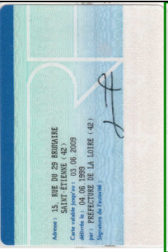

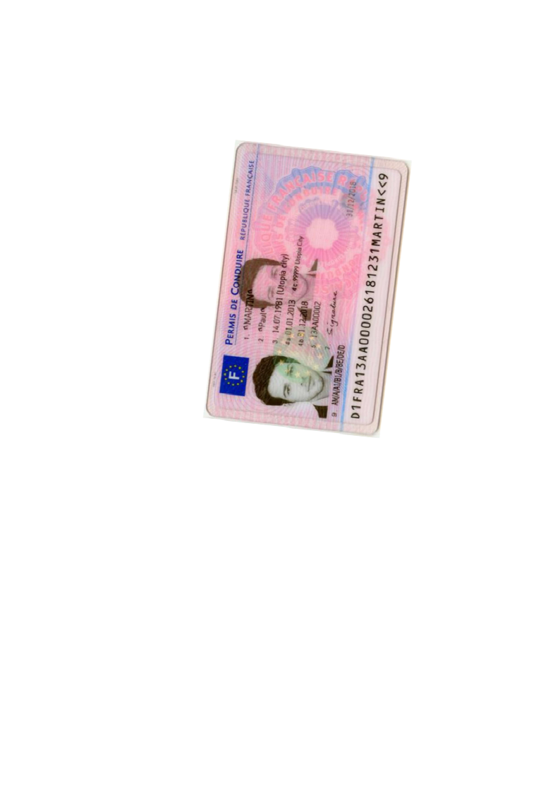
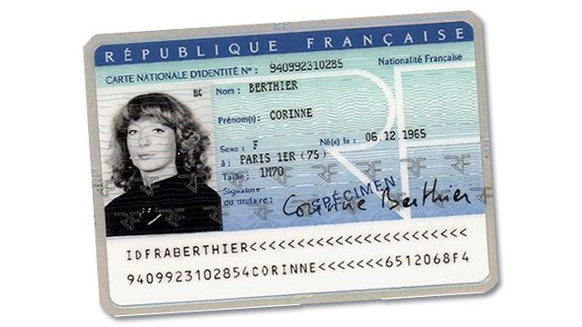
Page
Zoning
Homography
Zoning
OCR
Split
Split
Zoning
Homography
Zoning
OCR

Slide 6
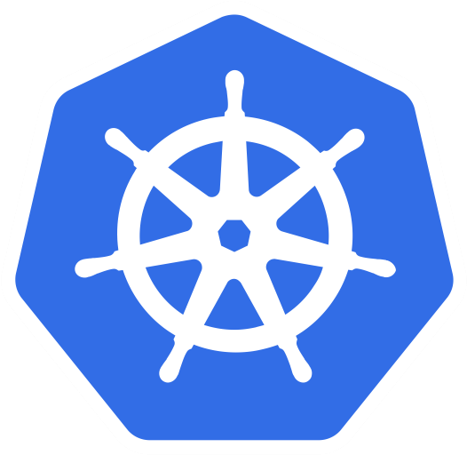


Notes:
As a platform, we’ve chosen OpenPaaS (which is an OpenShift).
OpenShift relies on Kubernetes and Docker (containers).
In this talk, I will not doing an exhaustive presentation of these guys. But I will summarize some concepts in order to explain to you the context of our story.
In our case, each application on each environment is represented by an object called a Namespace.
A day, a new OCR application was born.
This one allows us to read information from french driver licenses.
But this kind of application can be very complex with a lot of heavy services.

Slide 7



Axa France
OpenPaaS
Axa GO

Slide 8

$
XX,XXX € / month
Notes:
Finally, we had/encountered FinOps issues. And this made us very sad …
The infrastructure was too expensive and we were looking for solutions to decrease our costs.

Slide 9
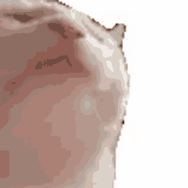
$
X,XXX € / month
÷ 10
$
Notes:
And today we are proud to announce that we have divided our costs by … 10 !!! And that make us very happy !
To achieve this goal, One of our solutions we built up was the dailycleanAPI.
A wonderful application which save our money and help to save our planet.

Slide 10
Why?
What?
How?
Why GraalVM & Quarkus?
Code!!!

Slide 11

24 hours per day | 7 days per week | 12 months per year
12 hours per day | 60 hours per week | 240 hours per months
Demonstration By Julien Hatzig

Slide 12
12 hours per day | 4,5 days per week | 7 months per year
67 %
Demonstration By Julien Hatzig

Slide 13
Why?
What?
How?
Why GraalVM & Quarkus?
Code!!!

Slide 14

creates
executes
CronJob
Job
schedule = 0 9 * * *
Notes:
In openShift, a container is called a pod.
And in our case, Each pod is an instance of a microservice.
In OpenShift, pods are replicated.
To extinct a pod, you can set its replica number to 0
To start a pod, you can set its replica number to 1, at least.
To do so, our ops developed a script which can set this number of replicas for all the pods of a namespace.
To execute this script, Kubernetes gives us an object called a Job.
To plan an execution of a job each day, Kubernetes gives us an object called a CronJob.
In other words, A CronJob create and execute a Job. The Job execute a script.
We can set a TTL to this job. Then, when the job finishes its execution, it deletes itself.

Slide 15



KUBERNETES API
CronJob start
Job start
Replicas = 1
DailycleanAPI
Replicas = 0
Job stop
CronJob stop
Job start
Replicas = 1
DailycleanFront
Job stop
Replicas = 0
Notes:
To summarize:
When we want to start pods from a namespace, we create a Job to start them.
When we want to stop pods from a namespace, we create a Job to stop them.
When we want to update start/stop scheduling, we delete and create a new CronJob.
To create or delete Jobs and CronJobs, we can use the Kubernetes API
Finally, we had to develop a front and an API which calls the Kubernetes API to manage our pods.

Slide 16
Dailyclean is open sourced
https://github.com/AxaGuilDEv/dailyclean

Slide 17
Questions ?
guillaume.thomas@axa.fr
@gthomasIT

Slide 18
THANK YOU!!!

